Slide 1

The Shoe Store
http://the-shoe-store.herokuapp.com/
By Patrick Abou Sleiman
CSI 3540
Structures, techniques et normes du web

Slide 2



Technology Used
Ruby 2.3.3
Rails 5.0.1
Html 5
SASS 3
Bootstrap
PostgreSQL

Slide 3

Heroku
Heroku is a cloud platform that lets companies build, deliver, monitor and scale apps
Download Heroku CLI and upload your code from CMD

Slide 4
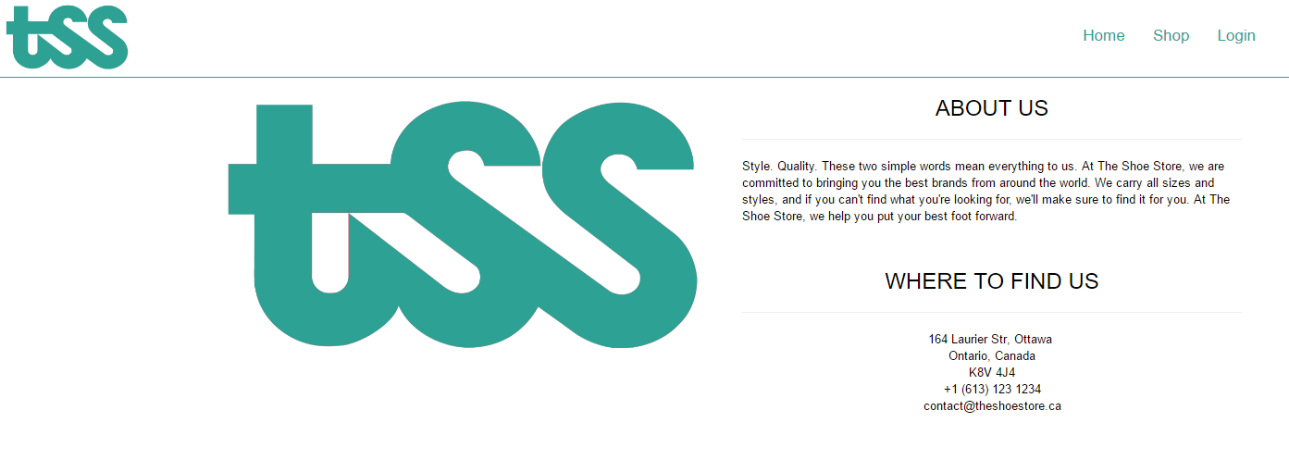

Slide 5
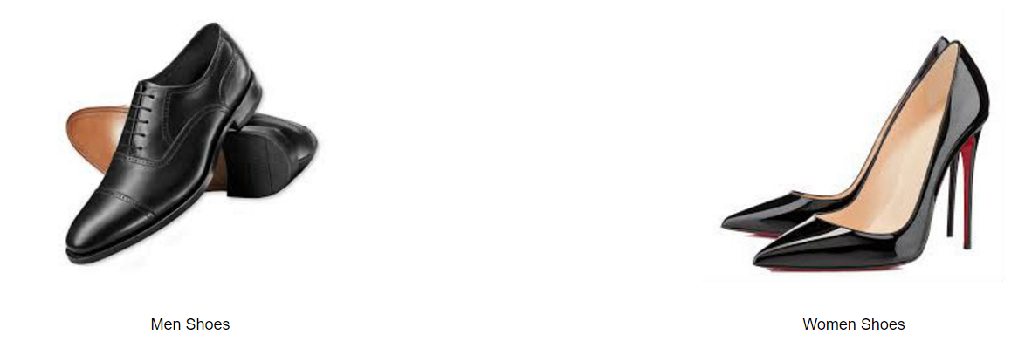
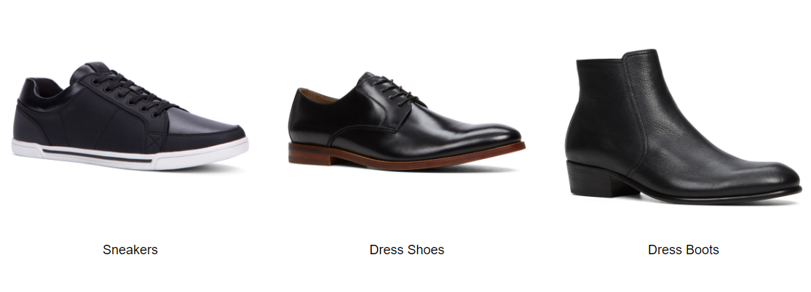
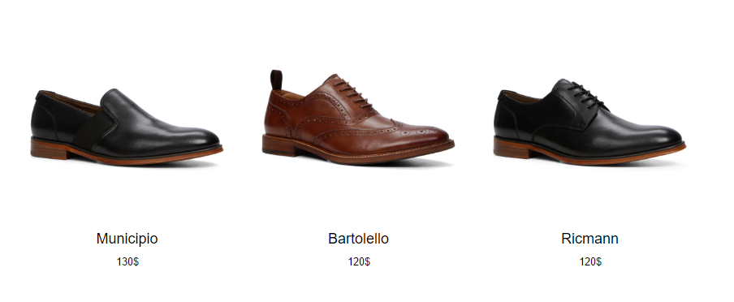

Slide 6
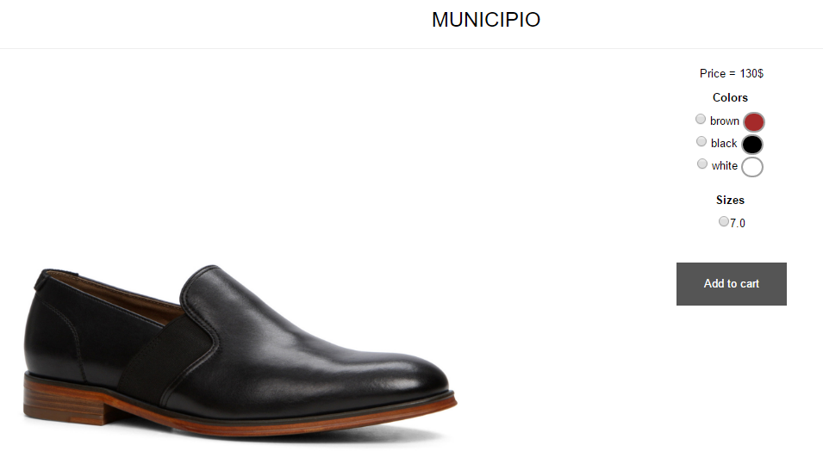

Slide 7

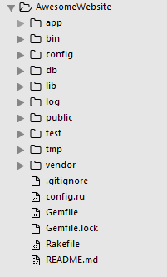
Why rails and not sinatra?
2
1
Easy and simple start: rails new awesome website
3

Slide 8
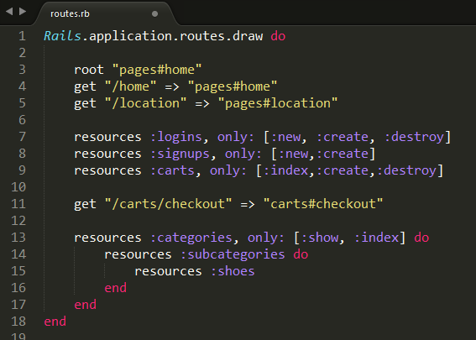
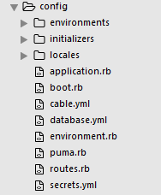
Why rails and not sinatra?
Config & routing: create restful resources in one line

Slide 9
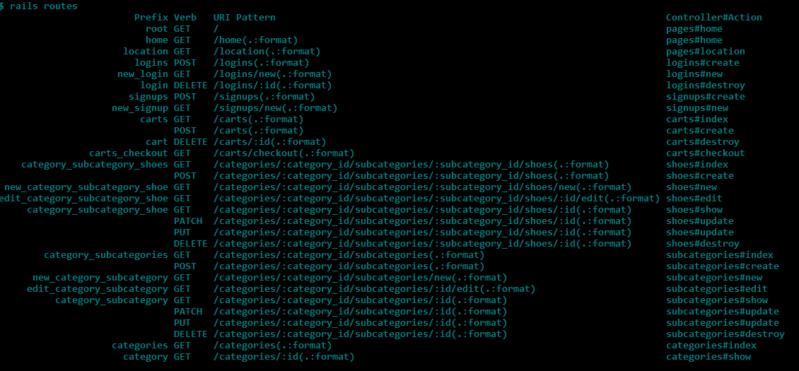

Slide 10
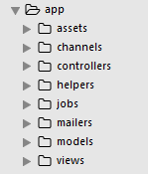
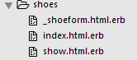
Why rails and not sinatra?
App contains all the website data. Using a specific naming convention, the server can tie the controller to the model and view

Slide 11
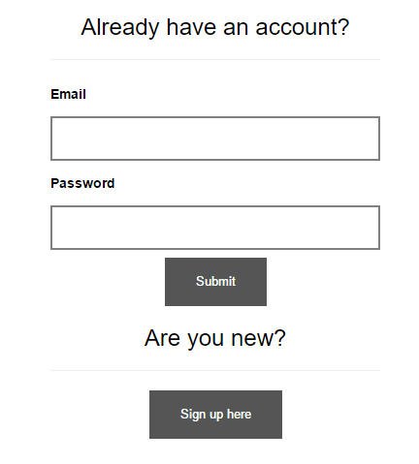
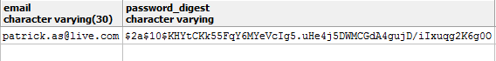
Gem used: bcrypt
An easy way to keep your users' passwords secure

Slide 12
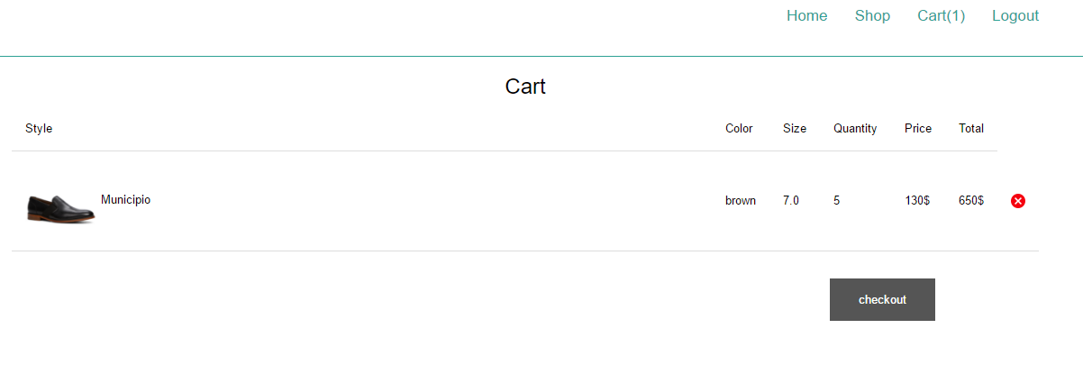
Login mini-secret

Slide 13

Thank you!

